Slide 1
CSS
By Crystal Hess
http://csed.fun

Slide 2
Learning Goals
What is CSS?
Why should we use style sheets instead of embedded stylings?
How do you link a stylesheet to an HTML page?
What are some common CSS stylings?
What does it mean for a website to be responsive?
Vocab: CSS selector, CSS property, CSS value

Slide 3
Cascading Style Sheets
Allows us to change the look and feel of the content on the page
Put stylings in their own .css file
Makes styling multiple pages easier
Allows changing multiple pages easier
Style sheets must be linked to an html page to affect them
<link href=“style.css” type=“text/css” rel=“stylesheet” />

Slide 4
CSS declarations

Slide 5
CSS properties to know
color
background-color
text-align
margin
border
width
float
font-family
padding
clear
height

Slide 6
HTML5
Some new HTML5 elements are:
New semantic elements
like <header>, <footer>, <article>, and <section>
New attributes of form elements
like number, date, time, calendar, and range
New graphic elements
<svg> and <canvas>
New multimedia elements
<audio> and <video>

Slide 7
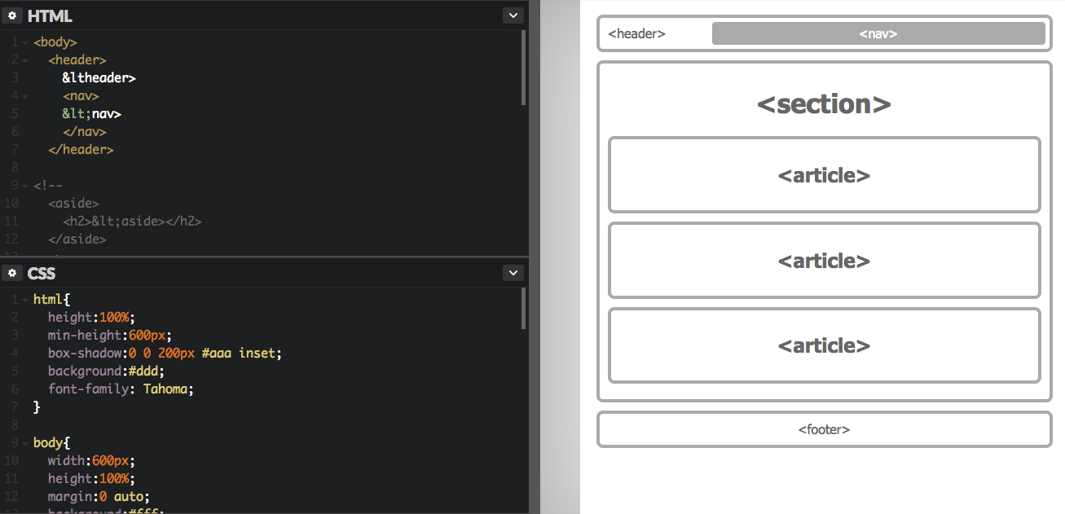
Example: HTML5 Styling
Open https://codepen.io/sudocrystal/pen/OjmBvE/

Slide 8
Responsive Design
Responsive Web Design makes your web page look good on all devices (desktops, tablets, and phones).
Responsive Web Design is about using CSS and HTML to resize, hide, shrink, enlarge, or move the content to make it look good on any screen.

